Slide 1
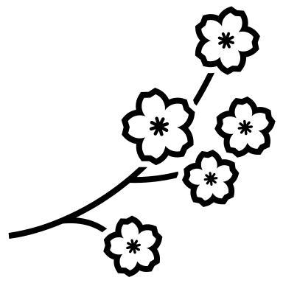

Plant Anatomy- Lecture 6
Complex tissues (Phloem tissue)

Slide 2
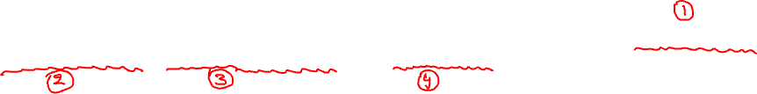
Phloem (Gk; phlois = bark)
It is a complex, living, mechanical, permanent, vascular tissue present in the vascular bundles. It is a principal Food conducting tissue commonly referred as Bast (ليف او لحاء)
Based on the origin and development two types of phloem are found
Primary Phloem – it is developed from pro cambium, and
Secondary Phloem – it is developed from Vascular cambium.
Phloem tissue composed of different types of cell elements – Sieve elements, Companion cells, Phloem parenchyma and Phloem fibers.

Slide 3


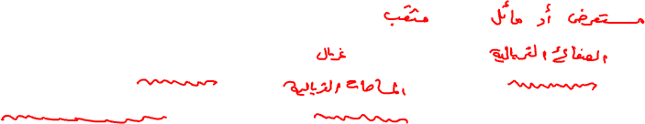
Sieve elements: the conducting elements of phloem are sieve elements. The less specialized cells are Sieve cells. The more specialized cells are called Sieve tube members.
Sieve cells: these are narrow elongated cells with tapering ends. These have sieve areas throughout the lateral walls and end walls. They are found in Pteridophytes and Gymnosperms.
Sieve tubes:
They are tube like, placed end to end, resemble (like تشبه) Xylem vessels, found in Angiosperms and form the main phloem elements.
The sieve tube members are living with perforated oblique or transverse end walls. The perforated end walls are like a sieve and are called Sieve plates. The perforated areas of sieve plates are known as Sieve areas.

Slide 4
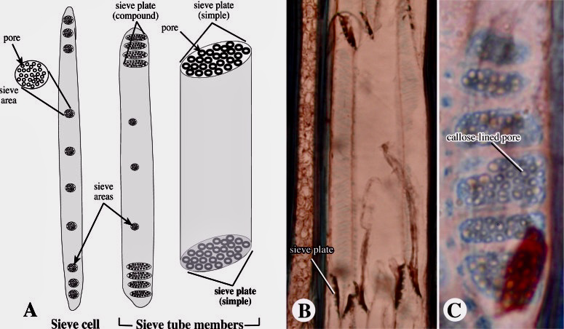


Slide 5


Sieve tubes comprise several to many enucleated sieve tube members inter connected via the sieve plates or sieve tube in a series. These are found only in Angiosperms.
The cell wall is thin in most and thick (due deposition of Pectin) in few and made up of cellulose.
During winter, the sieve areas are covered by the deposit of colorless shining substance in the form of a layer called callus.

Slide 6
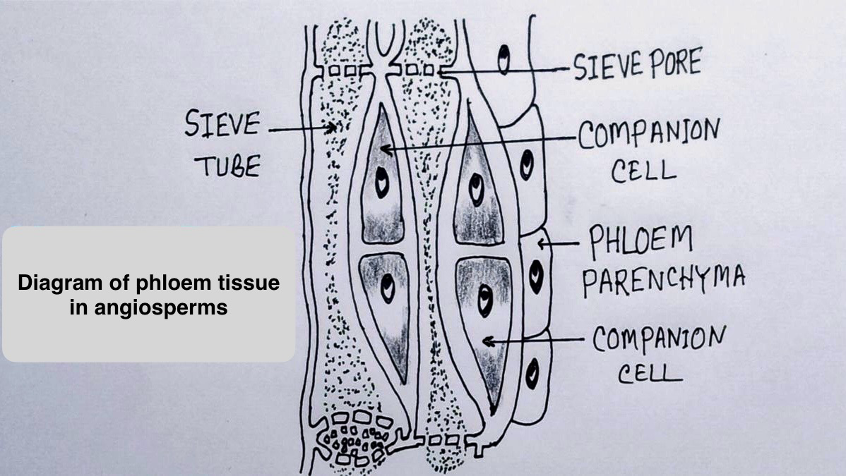
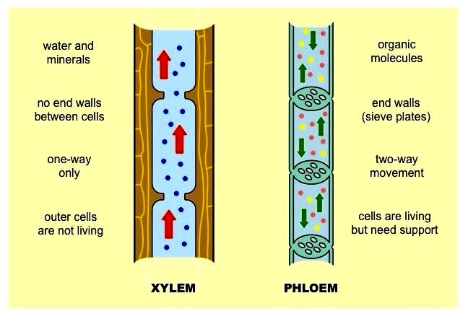

Slide 7
Function of Sieve cells and Sieve tubes:
Sieve cells and Sieve tubes are the chief food conducting elements of phloem. They transport the prepared food materials.
Companion cells: They are living nucleated specialized parenchymatous cell with dense cytoplasm, associated with a sieve tube in origin, position and function. They develop from same Meristematic cell and gives rise to the sieve element. Usually a single companion cell is found associated with Sieve tube member. The Sieve tube members and Companion cells are interdependent, as the companion cell nucleus directs the activities of Sieve tube cell. If one dies, the other will die soon.

Slide 8
Functions of companion cells:
They are involved in the conduction of food materials.
The companion cell nucleus directs the activities of Sieve tube cell.
They are involved in the maintenance of pressure gradient in the sieve tubes.

Slide 9
Phloem parenchyma: The parenchymatous cells found associated with phloem and are living cells with dense cytoplasm and nucleus. It is found as the component of phloem of Gymnosperms and Dicotyledons of Angiosperms. In dicotyledons the phloem parenchyma store starch, oil, and other food substances and accumulate tannins and resins.
Phloem fibers: Bast fibers: the sclerenchymatous fibers found associated with phloem and are long lignified; provide mechanical strength to the plant body. The phloem fibers have commercial value used in industries.

Slide 10
